Slide 1


Mobile application development using Android Studio
S. Durga Praveena
MAD Lab
IDRBT

Slide 2
Overview
Create a New Project
Working with the activity_main.xml file
Working with the MainActivity.java file

Slide 3
Arithmetic Operations
Create a simple calculator which can perform basic arithmetic operations like addition, subtraction, multiplication, or division depending upon the user input.
we are going to implement this project using the Java language.

Slide 4
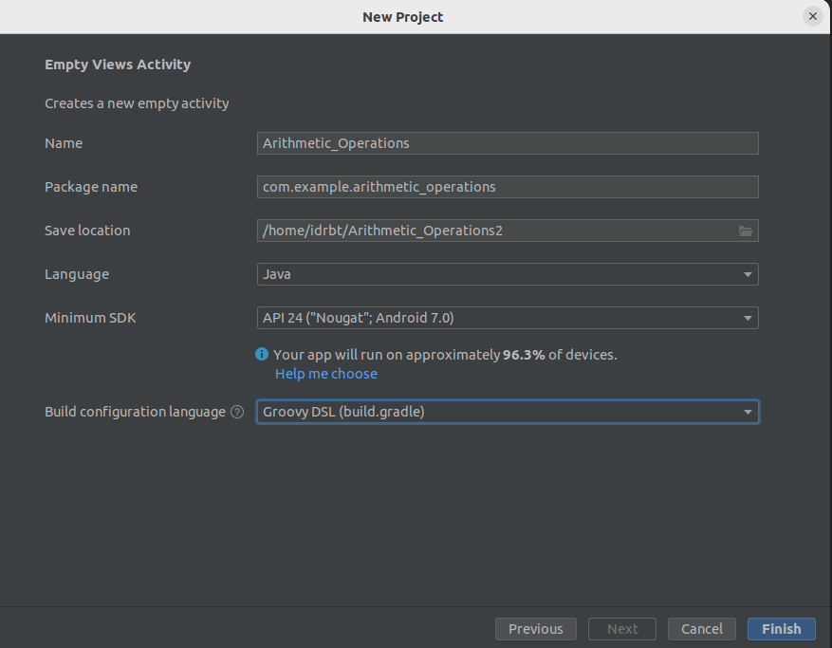
Create New Project

Slide 5
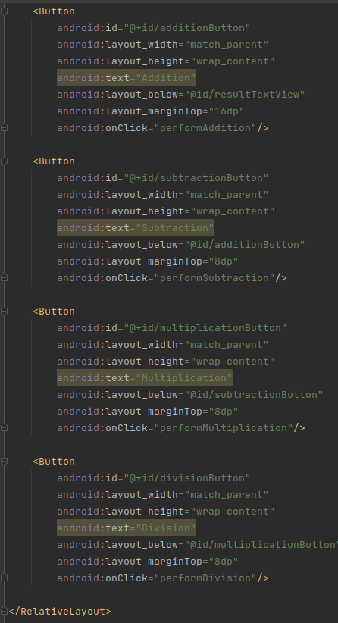
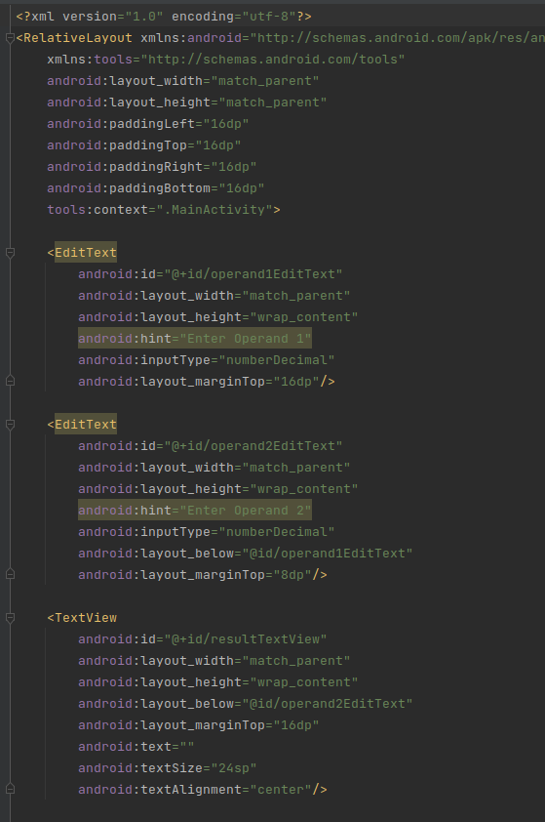
Working with the activity_main.xml file
Navigate to the app > res > layout > activity_main.xml and add the below code to that file. Below is the code for the activity_main.xml file.

Slide 6
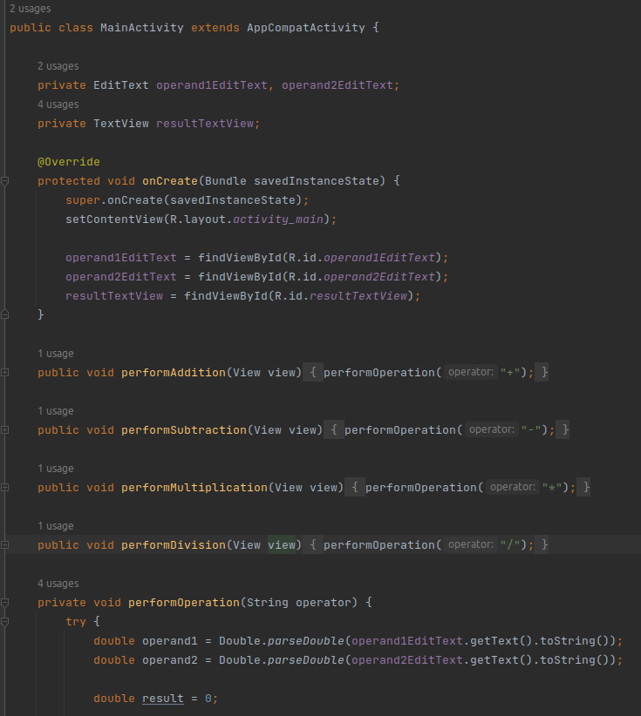
Working with the MainActivity.java file

Slide 7
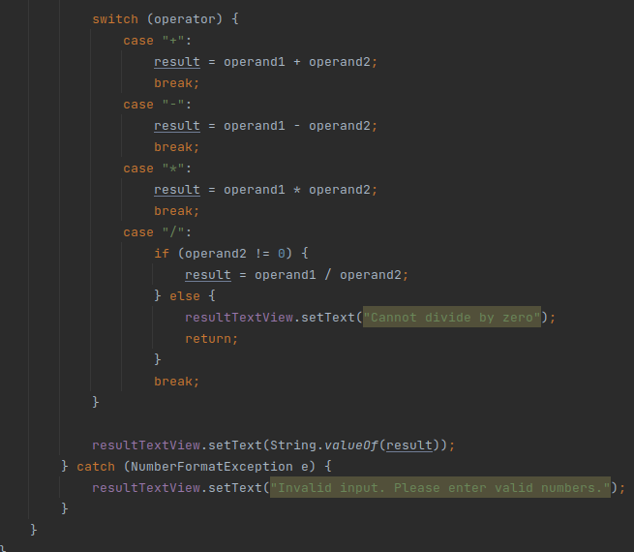
Layout Types

Slide 8
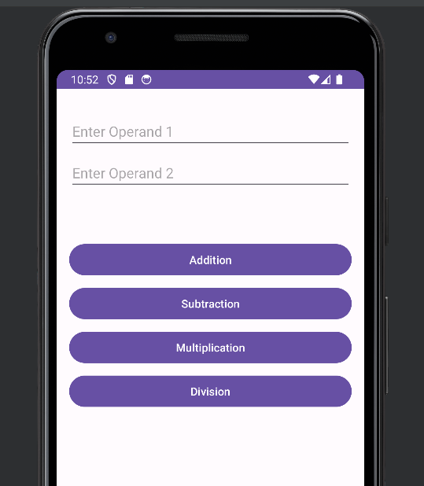
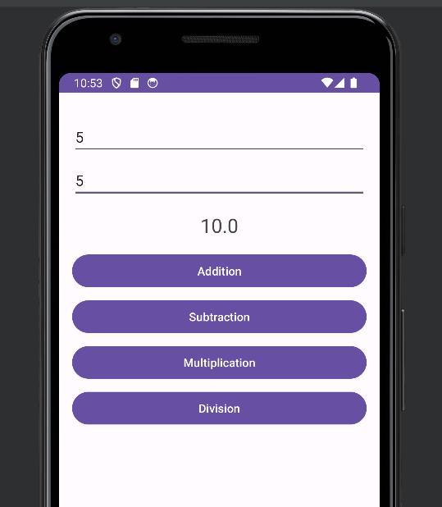
Layout Types

Slide 9
THANK YOU

